Slide 1
TDD Test-Driven Development
With Python

Slide 2
TOC
Overview
Benefits
Tests later vs TDD
How TDD works
TDD is productive?
Hands on
Recommendations
References

Slide 3
Overview
“Test-Driven Development is a process in which you write the test before you write the code. And when all tests are passing, you clean your kitchen: you make the code better.”¹
TDD was discovery in 2003 by Kent Beck, that also is one of eXtreme Programming (XP) creator. The premise behind test-driven development, according to Kent Beck, is that all code should be tested and refactored continually.
End-to-End, Integration and unit testing are the core of continuous delivery.
1 - https://www.digite.com/agile/test-driven-development-tdd/

Slide 4
Test-Driven Development Is Not About Testing¹
The point is that by writing tests first and striving to keep them easy to write, you’re doing three important things.
01
You’re creating documentation, living, breathing, never out-of-date specifications (i.e. documentation).
02
You’re (re-)designing your code to make and keep it easily testable, that makes it clean, uncomplicated, and easy to understand and change.
03
You’re creating a safety net to make changes with confidence.
1 - https://www.digite.com/agile/test-driven-development-tdd/

Slide 5
Tests later vs TDD
The main responsible for the code quality is not the TDD itself, but the automated tests generated by the technique. So, what's the difference between creating tests later or using TDD?
FEEDBACK
Code feedback with TDD
code
Test
code
Test
code
Test
code
Test
Standard Approach
code
code
code
code
Tests
Code feedback

Slide 6
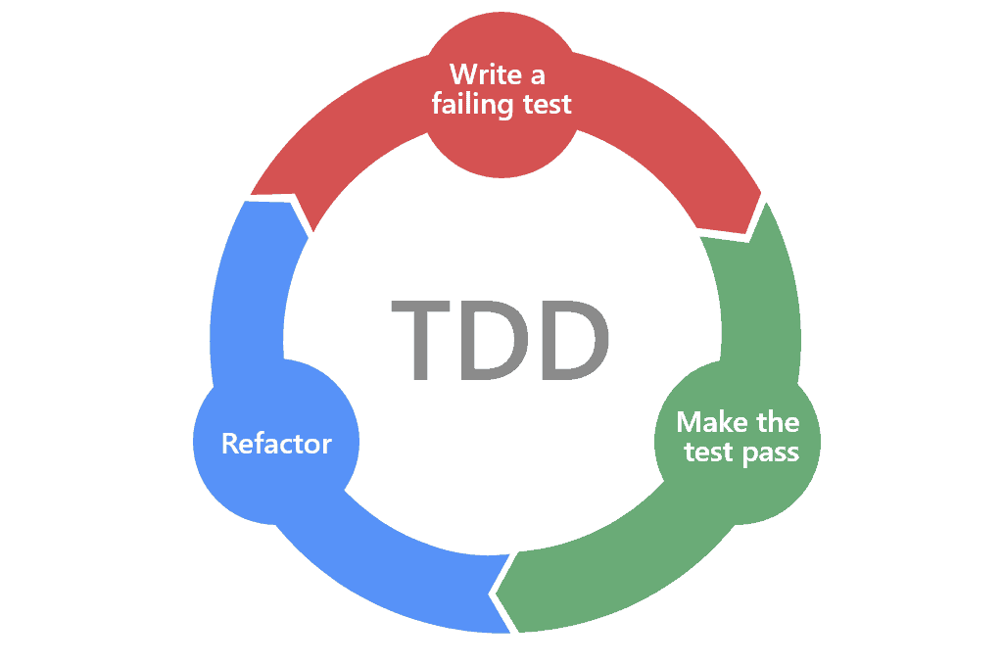
How TDD works
The mantra of Test-Driven Development is “red, green, refactor (blue).

Slide 7
TDD is Productive?
Yes, the developer will spend a good part of their time writing test code. But that doesn't mean he's less productive because of it.
Early bug notification
Easy bug diagnosis as the tests pinpoint what went wrong
Keeping the code clean
Easy to read your code for feature implementation or fixes
Less rework

Slide 8
TDD is Productive?
Academic studies
A structured experiment of test-driven development
“Experimental results, subject to external validity concerns, tend to indicate that TDD programmers produce higher quality code because they passed 18% more functional black-box test cases. However, the TDD programmers took 16% more time. Statistical analysis of the results showed that a moderate statistical correlation existed between time spent and the resulting quality.“
Laurie Williams https://www.sciencedirect.com/science/article/abs/pii/S0950584903002040
On the Influence of Test-Driven Development on Software Design
“Results from this study indicate that TDD can be an effective software design approach improving both code-centric aspects such as object decomposition, test coverage, and external quality, and developer-centric aspects including productivity and confidence. In addition, iterative development approaches that include automated testing demonstrated benefits over a more traditional linear approach with manual tests.“
D.S. Janzen https://ieeexplore.ieee.org/abstract/document/1617340

Slide 9
TDD is Productive?
Academic studies
“TDD can reduce between 40 and 80% bugs in production...”
A Comparative Case Study on the Impact of Test-Driven Development on Program Design and Test Coverage
Maria Siniaalto
Guest Editors' Introduction: TDD--The Art of Fearless Programming Ron Jeffries

Slide 10
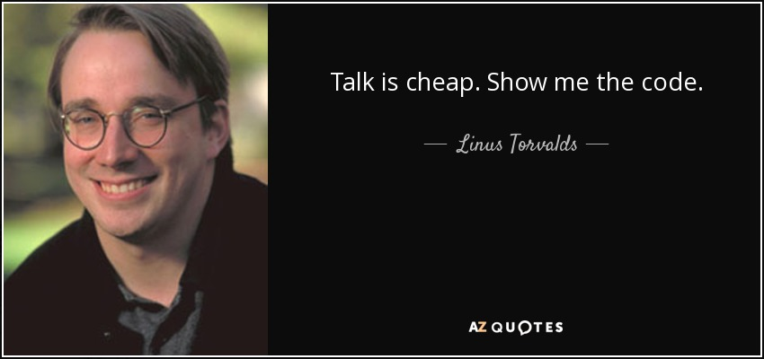
Hands On
Notes:
- Fatorial
- Factorial is the productive of all positive integers natural numbers. This is made multiplying a number immediately for your predecessor.

Slide 11
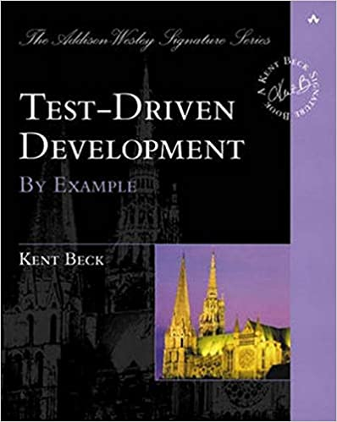
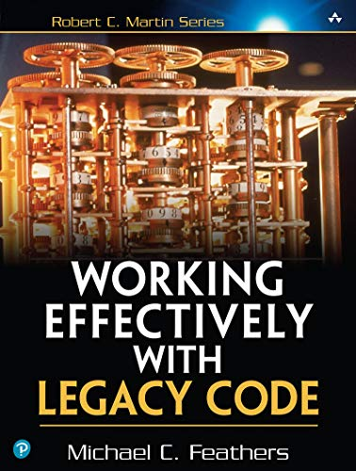
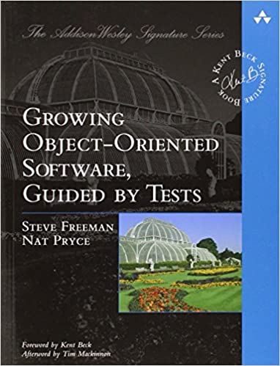
Recommendations
Test-Driven Development: By Example by Kent Beck
Working Effectively with Legacy Code by Robert C. Martin (Uncle Bob)
Growing Object-Oriented Software, Guided by Tests by Steve Freeman

Slide 12
References
https://www.digite.com/agile/test-driven-development-tdd/
https://coodesh.com/blog/pessoas-candidatas/metodologias/tdd-e-seu-significado-por-que-ele-ajuda-a-aumentar-a-sua-produtividade/
https://tdd.caelum.com.br/
https://marsner.com/blog/why-test-driven-development-tdd/
https://ieeexplore.ieee.org/abstract/document/1617340
https://ieeexplore.ieee.org/abstract/document/4455636

Slide 13
print(“Thank you!”)

